Slide 1
Estimating numerical calculations
Estimation and rounding

Slide 2
how to use Oak lessons

Slide 3
I can estimate numerical calculations.

Slide 4
Significant figures are the digits in a number that contribute to the accuracy of the number.
The first significant figure is the first non-zero digit.
Number lines can be used to round to one significant figure.
Example
6523 = 7000 (1 s.f.)
6523 = 6500 (2 s.f.)
6523 = 6520 (3 s.f.)

Slide 5
A quick estimate for a calculation is obtained from using approximate values, often rounded to 1 significant figure.
When showing estimations we use ≈ to identify that the calculations are approximately the same but not equal.
For example,

Slide 6

Estimating numerical calculations
Estimating using significant figures
Estimation in context

Slide 7
Estimating using significant figures
A quick estimate for a calculation is obtained from using approximate values, often rounded to 1 significant figure.
When we estimate, it is not required to be exact, but why do we estimate?
To make it easier and quicker to do calculations where the answer is very close to the actual answer.

Slide 8
Estimating using significant figures
When showing estimations we use ≈ to identify that the calculations are approximately the same but not equal.
For example,
All of these calculations will give an approximate answer to the calculation 892 × 176.9

Slide 9






Estimating using significant figures
For example, a typical car in the UK measures around 4.399 m long. Assuming the cars are bumper to bumper, what would the calculation be to work out an estimate length of the traffic jam?

Slide 10
Estimating using significant figures
You would be correct if you rounded 4.399 m to 1 s.f. to make 4 m giving an estimated answer of 20 m.
4 m
4 m
4 m
4 m
4 m

Slide 11
Estimating using significant figures
You would also be correct if you rounded 4.399 m to 2 s.f. to make 4.4 m giving an estimated answer of 22 m.
4.4 m
4.4 m
4.4 m
4.4 m
4.4 m

Slide 12
Estimating using significant figures
Rounding to 1 s.f. gave an estimated length of 20 m and rounding to 2 s.f. gave an estimated length of 22 m. Both are correct estimations, but what is the benefit to rounding to 1 s.f. or 2 s.f. ?

Slide 13
Estimating using significant figures
Rounding to 1 s.f. gave an estimated length of 20 m and rounding to 2 s.f. gave an estimated length of 22 m. Both are correct estimations, but what is the benefit to rounding to 1 s.f. or 2 s.f. ?
Rounding to 1 s.f. was quicker. Rounding to 2 s.f. was more accurate but perhaps took a little longer.

Slide 14
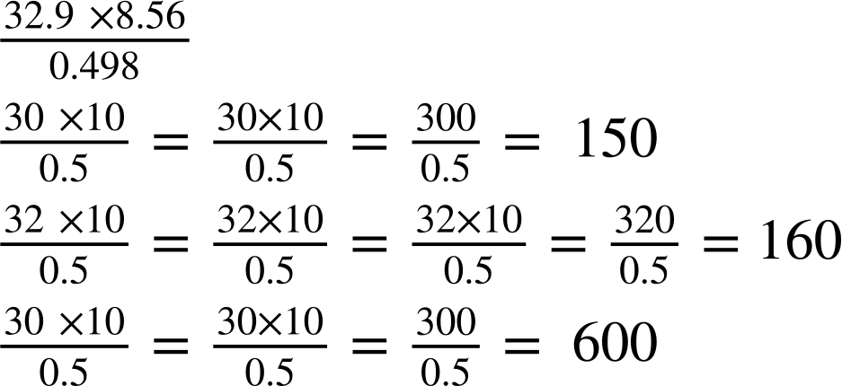
Estimating using significant figures
Izzy, Laura and Alex are given this calculation.
Who has correctly estimated the answer to the calculation?
Izzy
Laura
Alex

Slide 15
Estimating using significant figures
Izzy, Laura and Alex are given this calculation.
Who has correctly estimated the answer to the calculation?
Izzy
Laura
Alex
The rounded numbers by all three students are correct.

Slide 16
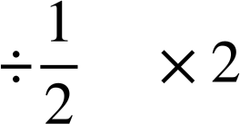

Estimating using significant figures
Izzy and Laura have made the same error when calculating the answer. When dividing by a number, it is the same as multiplying by its reciprocal.
Therefore when it is the same as , so Alex is correct.
Izzy
Laura
Alex

Slide 17
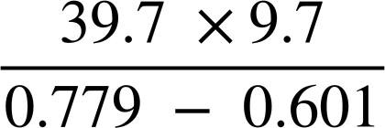
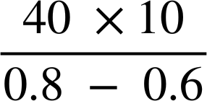

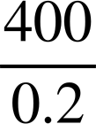
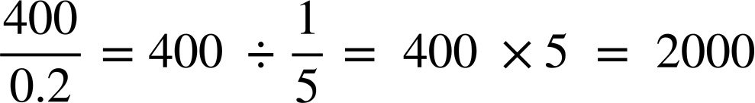
Estimating using significant figures
It is important to remember that the priority of operations still applies, even when we estimate.
For example, estimate
Suitably round
( )
( )
( …. )
Implicit brackets
⬚
⬚
⬚
× ÷
Division is the multiplication by the reciprocal.
+ −

Slide 18
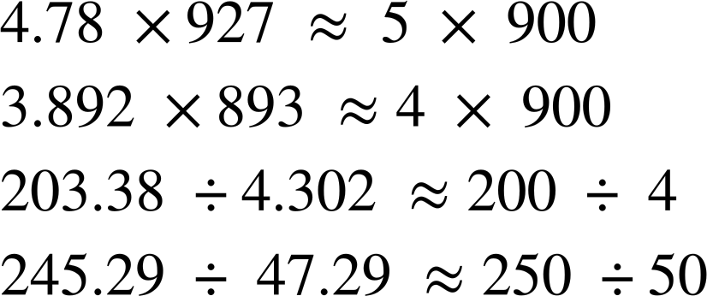
Estimating using significant figures
Fill in the gaps to make the approximations correct. You can only use each number once.
a)
b)
c)
d)

Slide 19

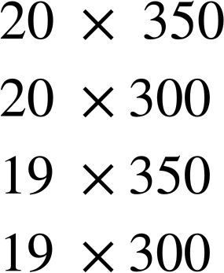
Estimating using significant figures
2) To estimate this,
a) Which of these calculations would you use? Explain your choice.
b) Which of these gives the closest estimate?
c) Which gives the estimate that is furthest away?

Slide 20
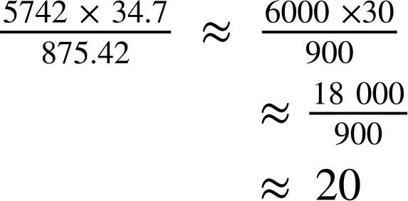
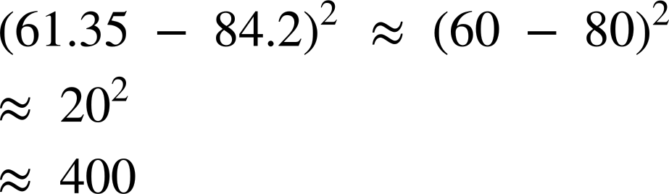
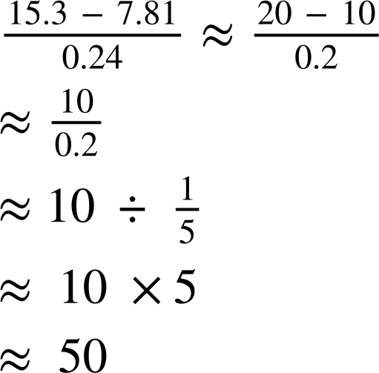

Estimating using significant figures
3) Estimate the following, making sure to show your working out.
a)
b)
c)
d)

Slide 21
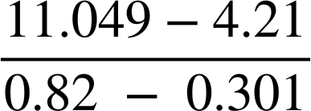
Estimating using significant figures
3) Estimate the following, making sure to show your working out.
e)
f)

Slide 22
Estimating using significant figures
Fill in the gaps to make the approximations correct. You can only use each number once.
a)
b)
c)
d)

Slide 23
Estimating using significant figures
2) To estimate this,
Which of these calculations would you use? Explain your choice.
There is no ‘right’ answer to this question, as long as there is justification to the calculation chosen.
For example, 20 × 350 is acceptable as 19.173 has been rounded to 1 s.f. and 338 has been rounded to the nearest 50.
20 × 300 is acceptable as 19.173 has been rounded to 1 s.f. and 338 has been rounded to 1 s.f.
19 × 350 is acceptable as 19.173 has been rounded to 2 s.f. and 338 has been rounded to the nearest 50.
19 × 300 is acceptable as 19.173 has been rounded to 2 s.f. and 338 has been rounded to 1 s.f.

Slide 24
Estimating using significant figures
2) To estimate this,
b) Which of these gives the closest estimate?
c) Which gives the estimate that is furthest away?
19 x 350 gives the closest estimate, since 19.173 is closer to 19 than 20 and 338 is closer to 350 than 300.
20 x 300 gives the estimate that is furthest away, since 20 is further from 19.173 than 19 and 300 is further from 338 than 350.

Slide 25
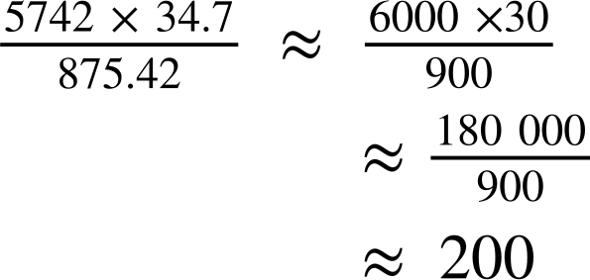

Estimating using significant figures
3) Estimate the following, making sure to show your working out.
e.g.
a)
b)

Slide 26
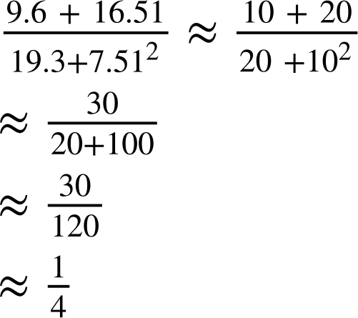
Estimating using significant figures
3) Estimate the following, making sure to show your working out.
c)
d)

Slide 27
Estimating using significant figures
3) Estimate the following, making sure to show your working out.
e)
f)

Slide 28
Estimating numerical calculations
Estimating using significant figures
Estimation in context

Slide 29


Estimation in context
Having a general estimate of everyday things, can allow us to estimate other calculations.
For example,
A standard full size guitar is always considered to be generally 1 m in length.
Using this, can you estimate the height of the cat?
1 m

Slide 30
Estimation in context
How did you decide on this estimate?
There are lots of different ways.
Perhaps estimate where the middle of 1 m would be and see that the cat is below it.
1 m

Slide 31
Estimation in context
How did you decide on this estimate?
There are lots of different ways.
Perhaps imagine, how many cats would make 1 m.
1 m

Slide 32
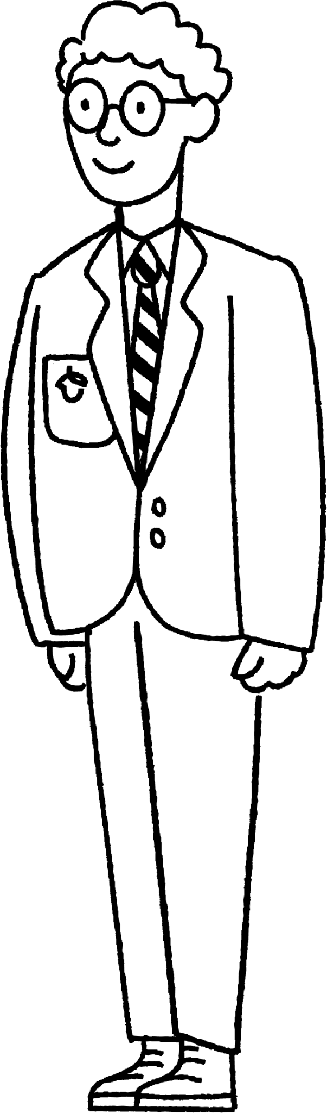
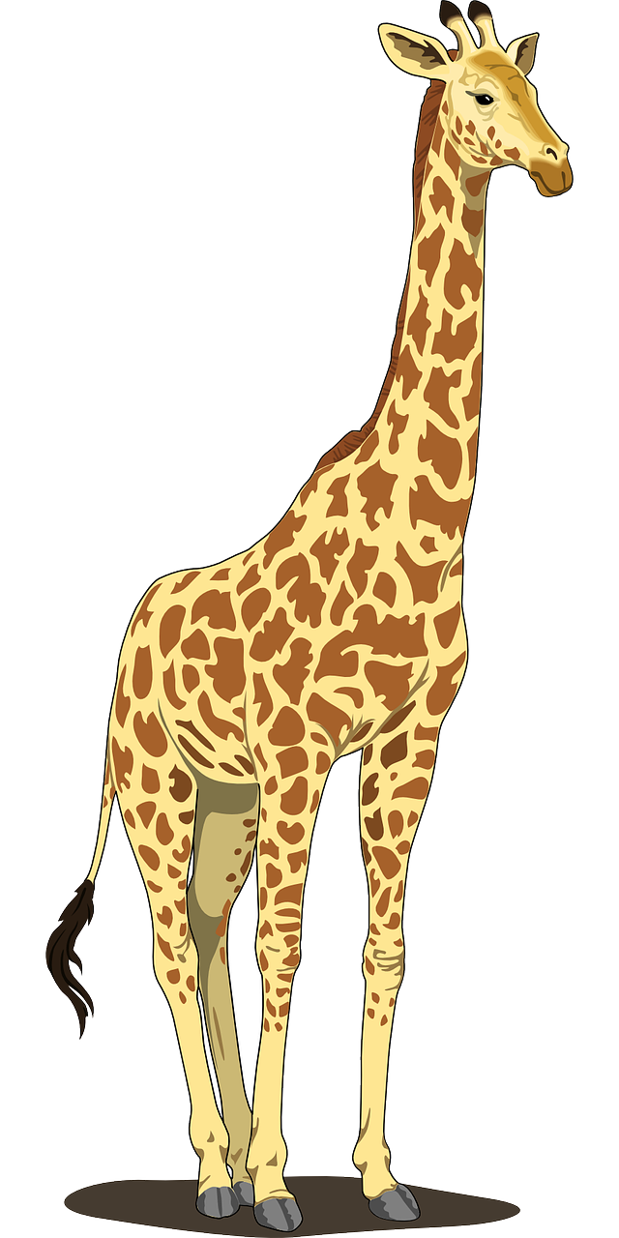
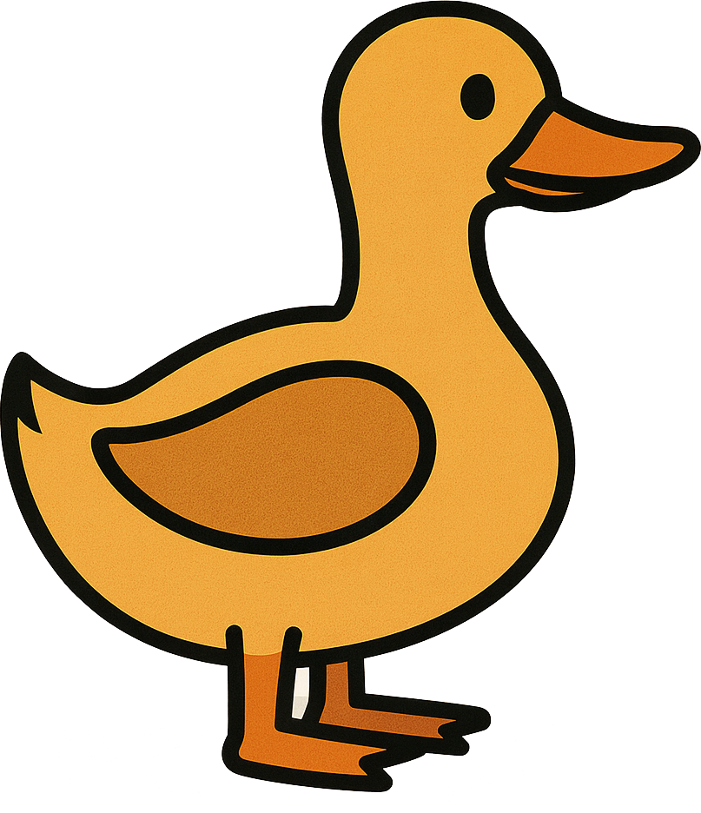
Estimation in context
A science textbook uses comparisons with humans to show the sizes of different animals.
Alex is of average height for a pupil in secondary school. Which of these is a good estimate for Alex’s height?
1.5 m 1.9 m 2.5 m
Use your answer to part a to estimate the height of the animals below.
Height ≈ 3m
Height ≈ 30 cm
b)
c)
The duck is approximately a fifth the height of Alex.
The giraffe is approximately twice the height of Alex.

Slide 33
Estimation in context
Alongside the general knowledge of approximate sizes of everyday things, it is also important to know the most appropriate unit of measure.
Can you name as many metric units of measure for length, mass and capacity as you can?
Length:
mm, cm, m, km …
Mass:
mg, g, kg …
Capacity:
ml, cl, l, …

Slide 34
Estimation in context
a) What would be a sensible unit of capacity to measure each of the items in the table?
b) Each of the values below matches one of the six items. Which is which?
drink bottle | pond | swimming pool
petrol tank | cup of tea | dose of medicine
1500
500
L
ml
375 000
L
ml
5
55
300
ml
L
375 000 | 5 | 55 | 500 | 1 500 | 300

Slide 35

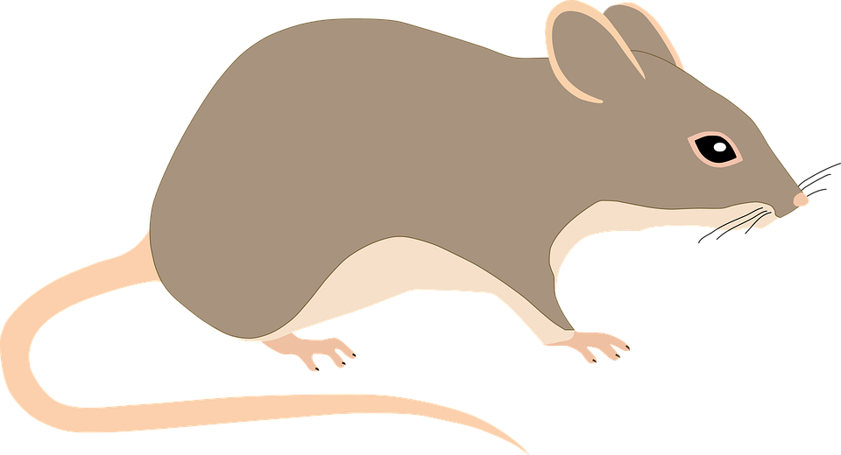
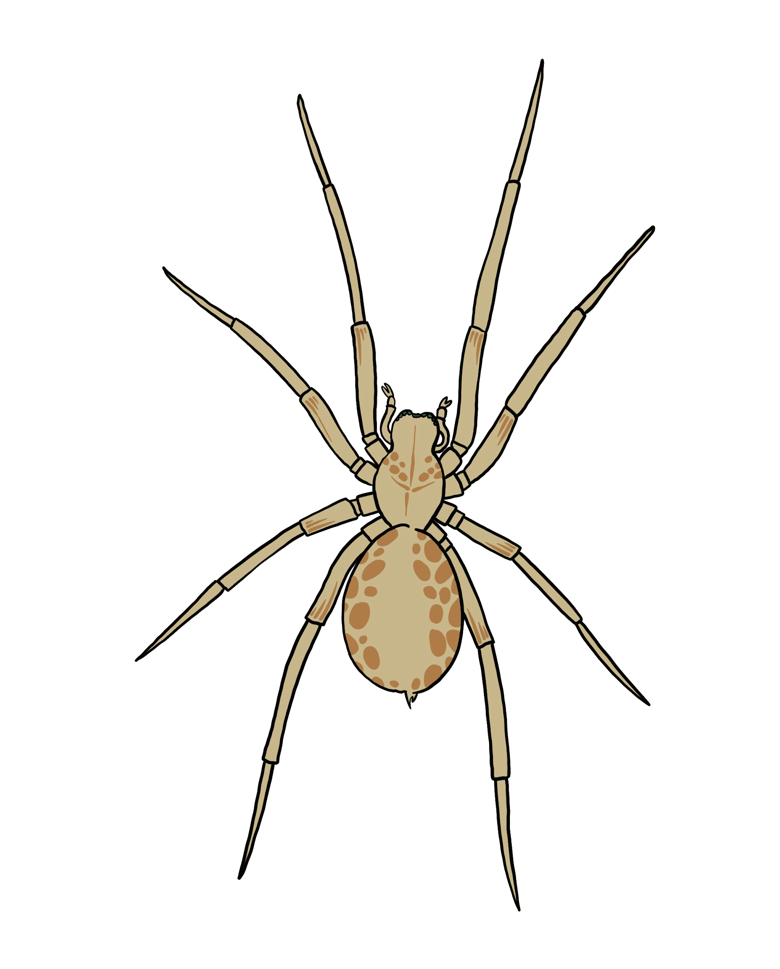
Estimation in context
A science textbook uses comparisons with humans to show the sizes of different animals.
Which of these is a good estimate for the width of the hand?
10 cm 25 cm 5 cm
Use your answer to part a to estimate the size of the animals below.
Length
Length
b)
c)

Slide 36
Estimation in context
2) a) What would be a sensible unit of mass to measure each of the items in the table?
b) Each of the values below matches one of the six items. Which is which?
c) An orange weighs approximately 120 g. How many oranges do you think would be the equivalent of one of each of the things in part a?
baby | elephant | full suitcase
cargo ship container | newborn puppy | packet of crisps
4000 | 3.2 | 120 | 28 | 19 | 2797

Slide 37
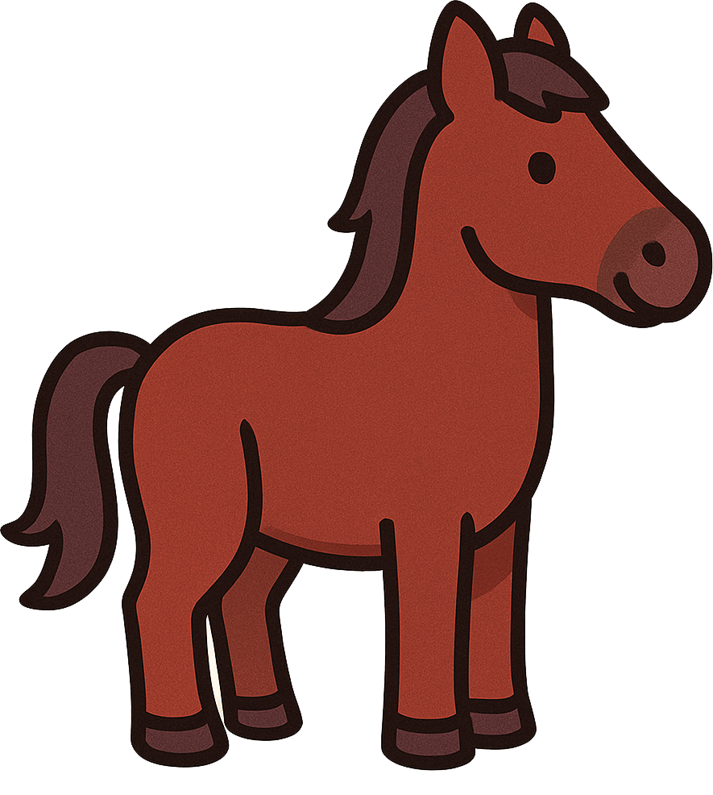
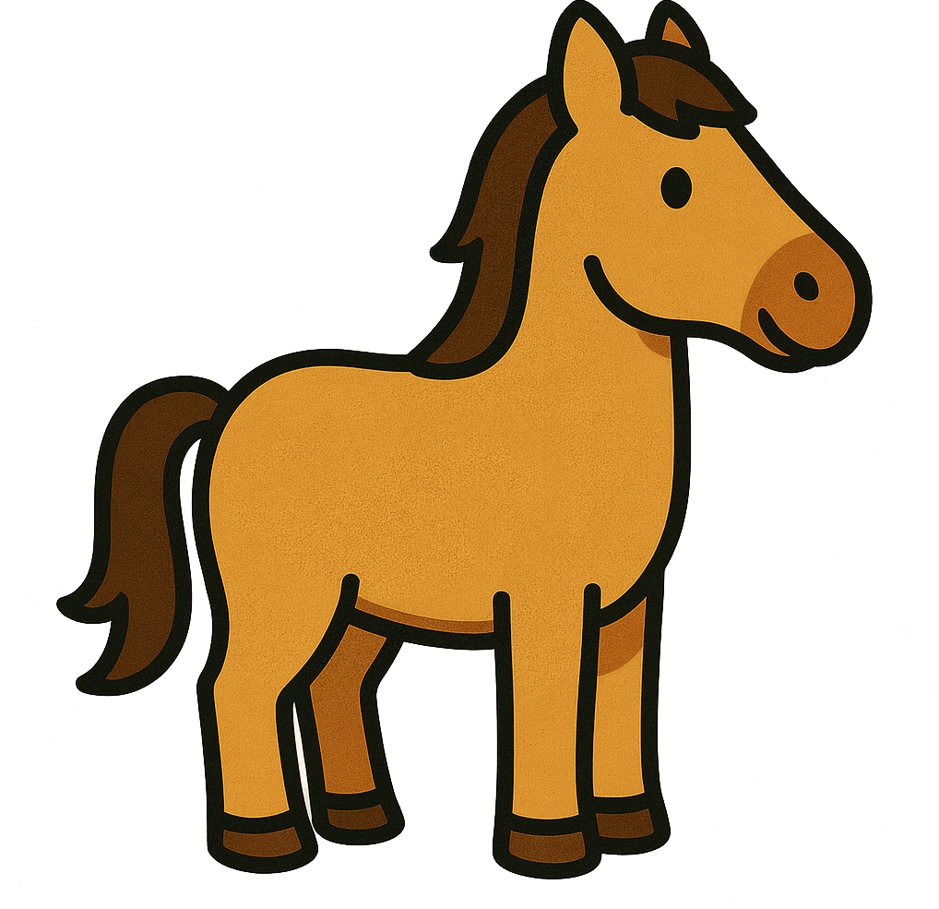
Estimation in context
3) Horses are measured using ‘hands’ as a unit, as shown below.
a) Estimate the height in centimetres of each of the horses.
b) The standard metric equivalent for a hand is 10.2 cm. Does this mean your estimate will be too big, too small or just right?
c) How many hands high are you to the top of your head?
d) Estimate some other objects using hands as a unit.

Slide 38
Estimation in context
A science textbook uses comparisons with humans to show the sizes of different animals.
Which of these is a good estimate for the width of the hand?
10 cm 25 cm 5 cm
Use your answer to part a to estimate the size of the animals below.
Length ≈ 15 cm
Length ≈ 3 cm
b)
The spider is approximately a third of the width of a hand
The rodent is approximately 1.5 times the width of a hand
c)

Slide 39
Estimation in context
2) a) What would be a sensible unit of mass to measure each of the items in the table?
b) Each of the values below matches one of the six items. Which is which?
baby | elephant | full suitcase
cargo ship container | newborn puppy | packet of crisps
kg
3.2
4000
kg
kg
19
g
28
2797
120
g
kg
4000 | 3.2 | 120 | 28 | 19 | 2797

Slide 40
Estimation in context
2) What would be a sensible unit of mass to measure each of the items in the table?
c) An orange weighs approximately 120 g. How many oranges do you think would be the equivalent of one of each of the things in part a?
baby | elephant | full suitcase
cargo ship container | newborn puppy | packet of crisps
kg
3.2
4000
kg
19
kg
g
28
2797
120
g
kg
Baby: approximately 25 oranges
Elephant: approximately 32 000 oranges.
Full suitcase: approximately 160 oranges
Cargo ship container: approximately 24 000 oranges
Newborn puppy: approximately 1 orange
Packet of crisps: approximately ¼ orange

Slide 41
Estimation in context
3) Horses are measured using ‘hands’ as a unit, as shown below.
a) Estimate the height in centimetres of each of the horses.
From left to right: 9 hands and 17 hands. Answers will vary depending on the estimate for the width of a hand: 9 × their estimate, 17 × their estimate. So, for example, if hand is estimated as 10 cm the answers will be 90 cm and 170 cm.

Slide 42
Estimation in context
3) Horses are measured using ‘hands’ as a unit, as shown below.
b) The standard metric equivalent for a hand is 10.2 cm. Does this mean your estimate will be too big, too small or just right?
If you used an estimate length of a hand to be less than 10.2 then your estimate will be too small, if you used a length greater than 10.2 cm then your estimate will be too big.

Slide 43
Estimating numerical calculations
A quick estimate for a calculation is obtained from using approximate values, often rounded to 1 significant figure.
When showing estimations we use ≈ to identify that the calculations are approximately the same but not equal.
Rounding to 1 s.f is general practice and quicker. Rounding to 2 s.f or more is more accurate but perhaps takes a little longer.
Having a general estimate of everyday things can allow us to estimate other calculations.

Slide 44

© Oak National Academy 2024.
Produced in partnership with Mathematics in Education and Industry.
Licensed on the Open Government Licence v3.0, except where otherwise stated. See Oak terms and conditions.

